Slide 1
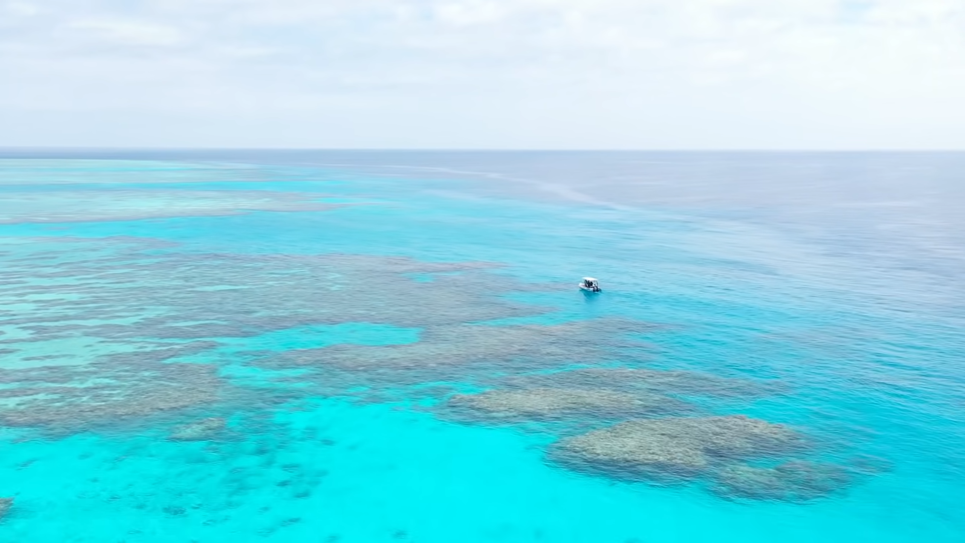
Great Barrier Reef Invasive Starfish Detector
Team 8
Nick Wagner | David Unger

Slide 2
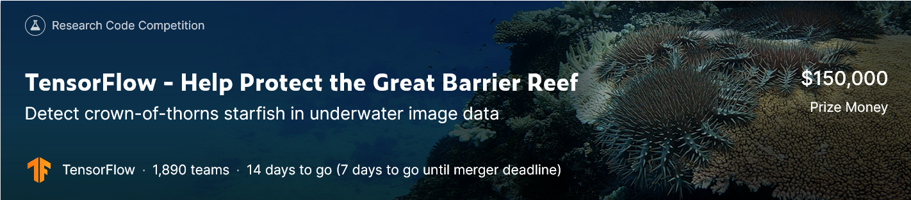
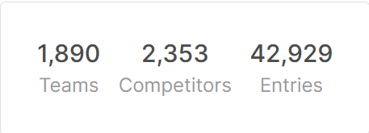
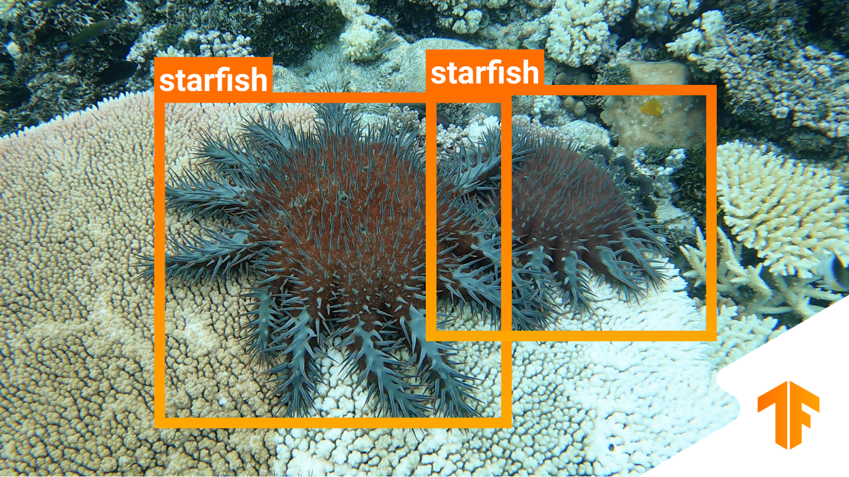
1 Problem Statement
Our goal: Implement a YOLO object detector from scratch
https://www.kaggle.com/c/tensorflow-great-barrier-reef/overview/description
https://www.google.com/url?sa=i&url=https%3A%2F%2Fblog.tensorflow.org%2F2021%2F11%2Fannouncing-tensorflows-kaggle-challenge.html&psig=AOvVaw3pZWcfWwVYD7HMyphUNG62&ust=1643789767389000&source=images&cd=vfe&ved=0CAsQjRxqFwoTCNCrpJ6I3vUCFQAAAAAdAAAAABAJ
Notes:
Dataset:
~23000 images from 3 video sequences
bounding box labels from csv
Challenge: Objects barely distinguishable from background

Slide 3
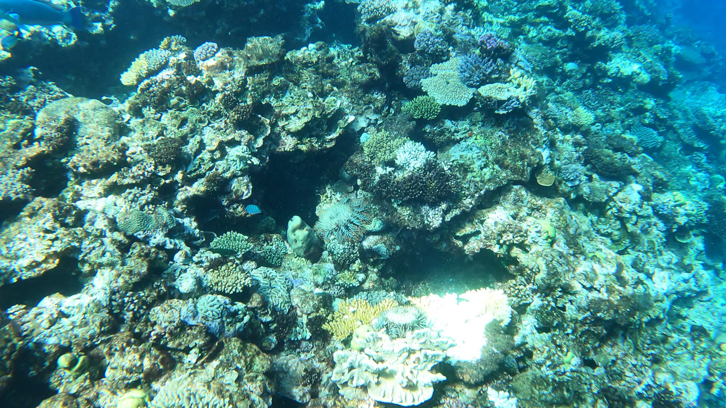
1 Problem Statement

Slide 4
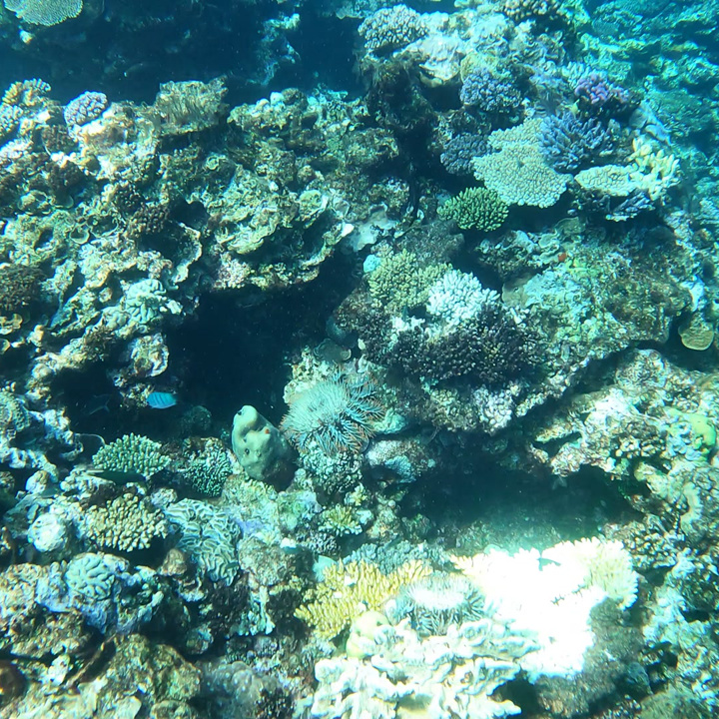
2 Our YOLO Architecture
448x448x3
14x14x2048
7x7x1024
7x7x1024
7x7x5
plot
3x3x1024 + stride = 2
conv. layer
3x3x5 + padding
conv. layer
details
input image
resnet50
dropout
objectness*
x-center*
y-center*
width*
height*
0 0 0 0 0 0 0
0 0 0 0 0 0 0
0 0 0 0 0 0 0
0 0 0 0 0 0 0
0 0 0 0 0 0 0
0 0 0 0 0 0 0
0 0 0 0 0 0 0
0 0 0 0 0 0 0
0 0 0 0 0 0 0
0 0 0 0 0 0 0
0 0 0 0 0 0 0
0 0 0 0 0 0 0
0 0 0 0 0 0 0
0 0 0 0 0 0 0
0 0 0 0 0 0 0
1
0 0 0 540 0 0 0
0 0 0 115 0 0 0
0 0 0 0 0 0
0 0 0 336 0 0 0
0 0 0 105 0 0 0
0 0 0 0 0 0 0
0 0 0 0 0 0 0
0 0 0 0 0 0 0
0 0 0 0 0 0 0
0 0 0 0 0 0 0
0 0 0 0 0 0
0 0 0 0 659 0 0
0 0 0 0 534 0 0
0 0 0 0 98 0 0
0 0 0 0 67 0 0
1
0 0 0 0 0 0 0
0 0 0 0 0 0 0
0 0 0 0 0 0 0
0 0 0 0 0 0 0
0 0 0 0 0 0 0
* For simplicity the values are denoted as pixel values. The implementation is relative to the grid.
Notes:
[{'x': 540, 'y': 336, 'width': 115, 'height': 105}, {'x': 659, 'y': 534, 'width': 98, 'height': 67}]“
WHY RELATIVE TO BOUNDING BOX?

Slide 5
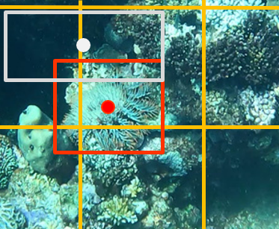
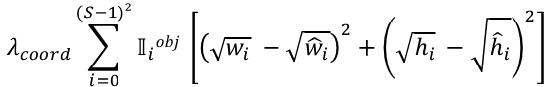
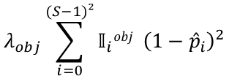
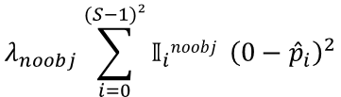
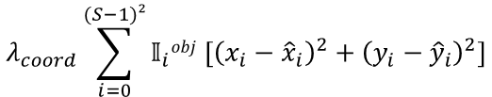
3 Loss Function
Bounding box center loss
Δx
Bounding box size loss
Object loss
No object loss
Δw
0 0 0 0 0 0 0
0 0 0 0 0 0 0
0 0 0 0 0 0 0
0 0 0 0 0 0 0
0 0 0 0 0 0 0
0 0 0 0 0 0 0
Δy
1
0 0 0 0 0 0
1
0 0 0 0 0 0
0 0 0 0 0 0 0
0 0 0 0 0 0 0
Δh
0 0 0 0 0 0
0 0 0 0 0 0
1
1
0 0 0 0 0 0 0
0 0 0 0 0 0 0
$$λ_{obj}\sum_{i=0}^{(S−1)²}{𝕀_{i}obj }{\left(1−{\hat{p}}_{i}\right)}^{2}$$
$$λ_{noobj}\sum_{i=0}^{(S−1)²}{𝕀_{i}noobj }{\left(0−{\hat{p}}_{i}\right)}^{2}$$
$$λ_{coord}\sum_{i=0}^{(S−1)²}{𝕀_{i}obj \left[{\left(x_{i}−{\hat{x}}_{i}\right)}^{2}+{\left(y_{i}−{\hat{y}}_{i}\right)}^{2}\right]}$$
$$λ_{coord}\sum_{i=0}^{(S−1)²}{𝕀_{i}obj \left[{\left({\sqrt{w_{i}}}_{ }−\sqrt{{\hat{w}}_{i}}\right)}^{2}+{\left({\sqrt{h_{i}}}_{ }−\sqrt{{\hat{h}}_{i}}\right)}^{2}\right]}$$

Slide 6


3 Approach
Detection input pipeline
Label conversion
YOLO architecture
Custom loss function
Visualization
Optimize the input pipeline
Transfer learning
Metrics
IOU
TP-rate / TN-rate
Seperate Loss functions
Data augmentation
color jittering
horizontal & vertical flip
Dropout
Smaller model capacity
Overfit on few training samples
Overfit on complete training set
Detector works on test set
…more during breakout!

Slide 7
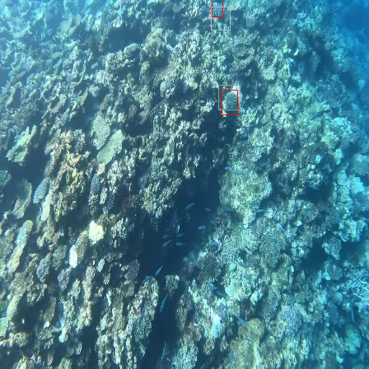
4 Results
Overfitting on Training Data
Ground Truth
Estimate
white: objectness = 1, black: objectness = 0

Slide 8
Thank you
Team 8
Nick Wagner | David Unger

Slide 9
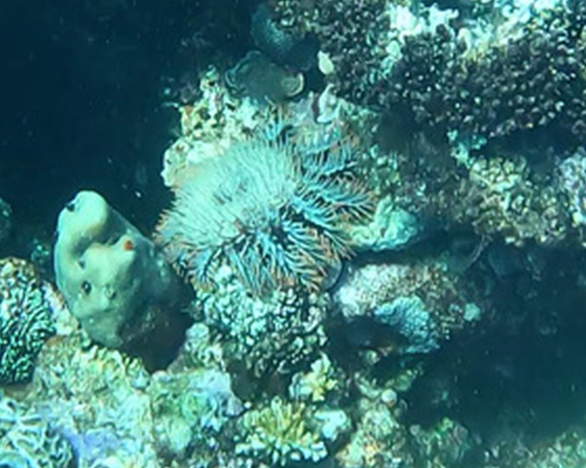
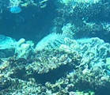
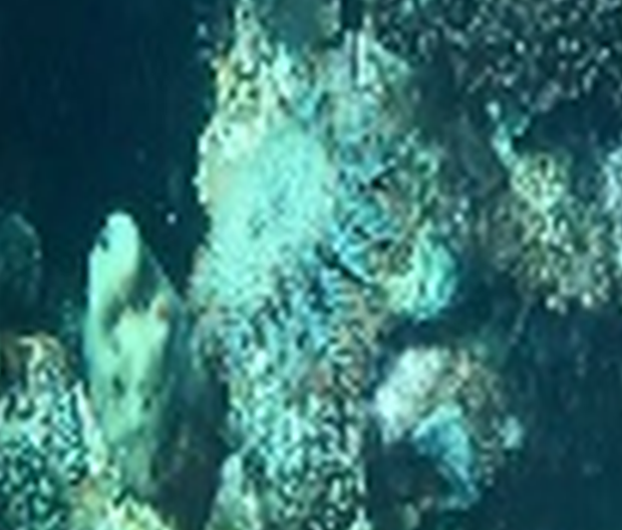
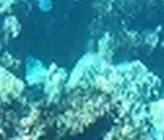
4 Results
Good example
Average example
Original resolution
Cropped from 1280x720 image
Original resolution
Cropped from 448x448 image

Slide 10
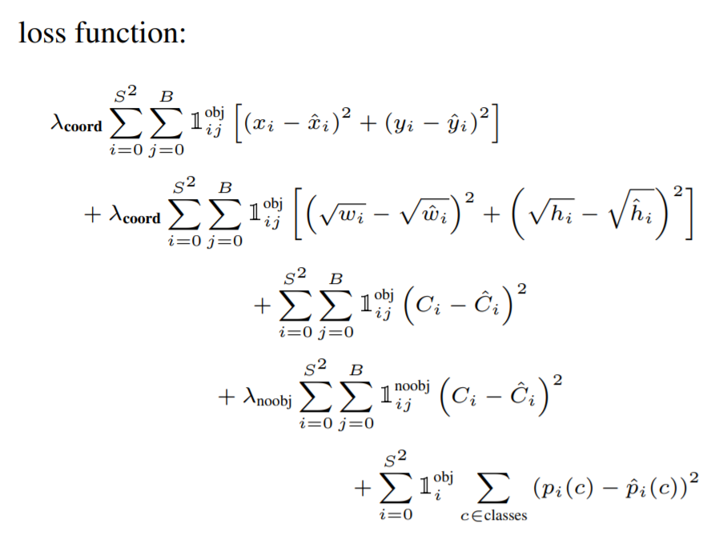
Backup – YOLO loss function

Slide 11
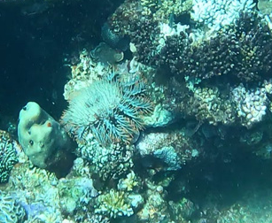
Backup

Slide 12
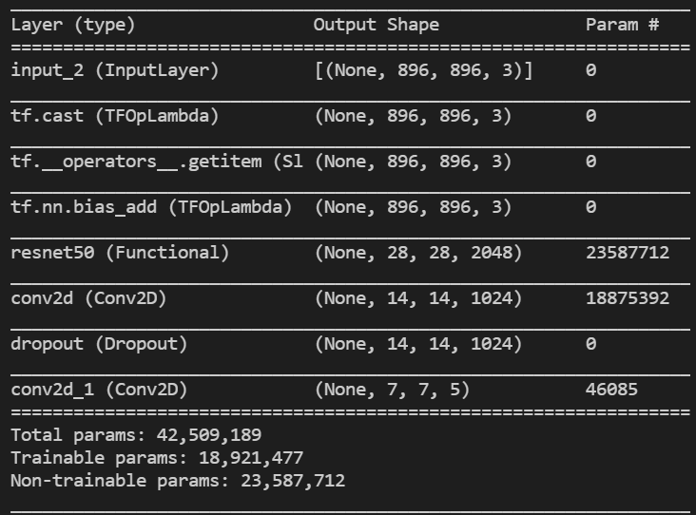
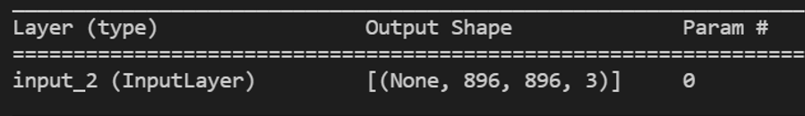
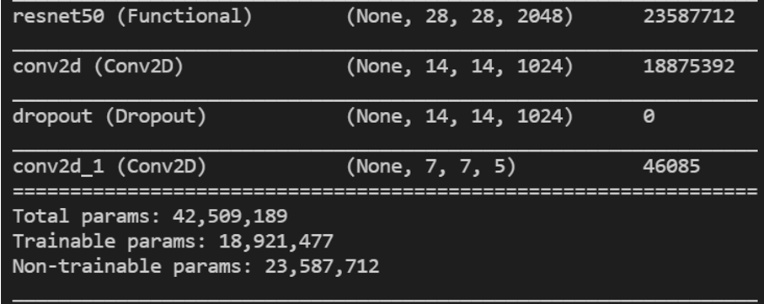
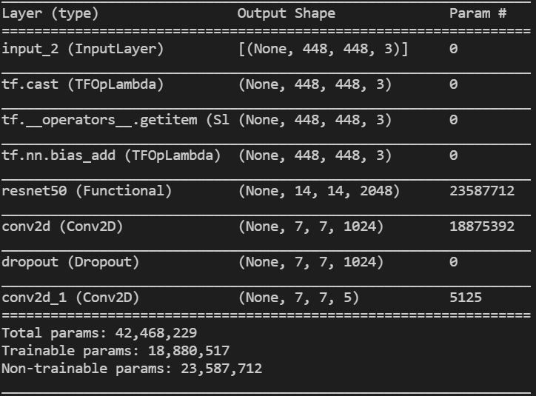
objectness
x-center
y-center
width
height
0 0 0 0 0 0 0
0 0 0 0 0 0 0
0 0 0 0 0 0 0
0 0 0 0 0 0 0
0 0 0 0 0 0 0
0 0 0 0 0 0 0
0 0 0 0 0 0 0
0 0 0 0 0 0 0
0 0 0 0 0 0 0
0 0 0 0 0 0 0
0 0 0 0 0 0 0
0 0 0 0 0 0 0
0 0 0 0 0 0 0
0 0 0 0 0 0 0
0 0 0 0 0 0 0
1
0 0 0 540 0 0 0
0 0 0 115 0 0 0
0 0 0 0 0 0
0 0 0 336 0 0 0
0 0 0 105 0 0 0
0 0 0 0 0 0 0
0 0 0 0 0 0 0
0 0 0 0 0 0 0
0 0 0 0 0 0 0
0 0 0 0 0 0 0
0 0 0 0 0 0
0 0 0 0 659 0 0
0 0 0 0 534 0 0
0 0 0 0 98 0 0
0 0 0 0 67 0 0
1
0 0 0 0 0 0 0
0 0 0 0 0 0 0
0 0 0 0 0 0 0
0 0 0 0 0 0 0
0 0 0 0 0 0 0
objectness
x-center
y-center
width
height
0 0 0 0 0 0 0
0 0 0 0 0 0 0
0 0 0 0 0 0 0
0 0 0 0 0 0 0
0 0 0 0 0 0 0
0 0 0 0 0 0 0
0 0 0 0 0 0 0
0 0 0 0 0 0 0
0 0 0 0 0 0 0
0 0 0 0 0 0 0
0 0 0 0 0 0 0
0 0 0 0 0 0 0
0 0 0 0 0 0 0
0 0 0 0 0 0 0
0 0 0 0 0 0 0
1
0 0 0 0 0 0 0
0 0 0 0 0 0 0
0 0 0 0 0 0 0
0 0 0 0 0 0
0 0 0 0 0 0 0
0 0 0 0 0 0 0
0 0 0 0 0 0 0
0 0 0 0 0 0 0
0 0 0 0 0 0 0
0 0 0 0 0 0 0
0 0 0 0 0 0
0 0 0 0 0 0 0
0 0 0 0 0 0 0
0 0 0 0 0 0 0
0 0 0 0 0 0 0
1
0 0 0 0 0 0 0
0 0 0 0 0 0 0
0 0 0 0 0 0 0
0 0 0 0 0 0 0
0 0 0 0 0 0 0

